Slide 1

Detailed Design Development
SPEED AND DELAY ASSESSMENT
JAYASHREE S,
B.Tech.ARTIFICIAL INTELLIGENCE
AND DATA SCIENCE,
VELAMMAL INSTITUTE OF TECHNOLOGY
THEME 3 : AI-based Traffic Data Generation and Monitoring Application

Slide 2

PROJECT OVERVIEW
• Detect vehicles in traffic video using lightweight OpenCV methods.
• Estimate congestion based on detected vehicle counts.
• Generate synthetic traffic speed data for Chennai.
• Visualize congestion levels on a geographic map.

Slide 3
METHODOLOGY
1. Vehicle Detection: OpenCV + Background Subtraction.
2. Traffic Analysis: Count vehicles across multiple frames.
3. Data Simulation: Generate speed data with random Chennai coordinates.
4. Congestion Classification: Based on simulated speed values.
5. Map Visualization: GeoPandas + Contextily for static PNG output.

Slide 4
VEHICLE DETECTION USING OpenCV
• Used BackgroundSubtractorMOG2 from OpenCV.
• Resized frames and cleaned foreground mask using morphology.
• Counted vehicles based on contour area > 300.
• Analyzed 30 frames to estimate traffic density.

Slide 5
SIMULATED TRAFFIC DATA - Chennai
• 30 synthetic points generated within Chennai bounds.
• Speed range adjusted using normal distribution (based on vehicle count).
• Congestion categories:
- Low: Speed > 40 km/h
- Medium: 20–40 km/h
- High: < 20 km/h

Slide 6
MAP VISUALIZATION
• GeoDataFrame used to map points by congestion level.
• EPSG:4326 converted to EPSG:3857 for map overlay.
• Contextily added OpenStreetMap basemap.
• Result saved as static PNG image (300 DPI).

Slide 7
MODEL / DEMO LINK
LINK :
https://drive.google.com/file/d/1baOBPMdAxR86jb2gOOK2xPhxwUNtyUKQ/view?usp=sharing

Slide 8
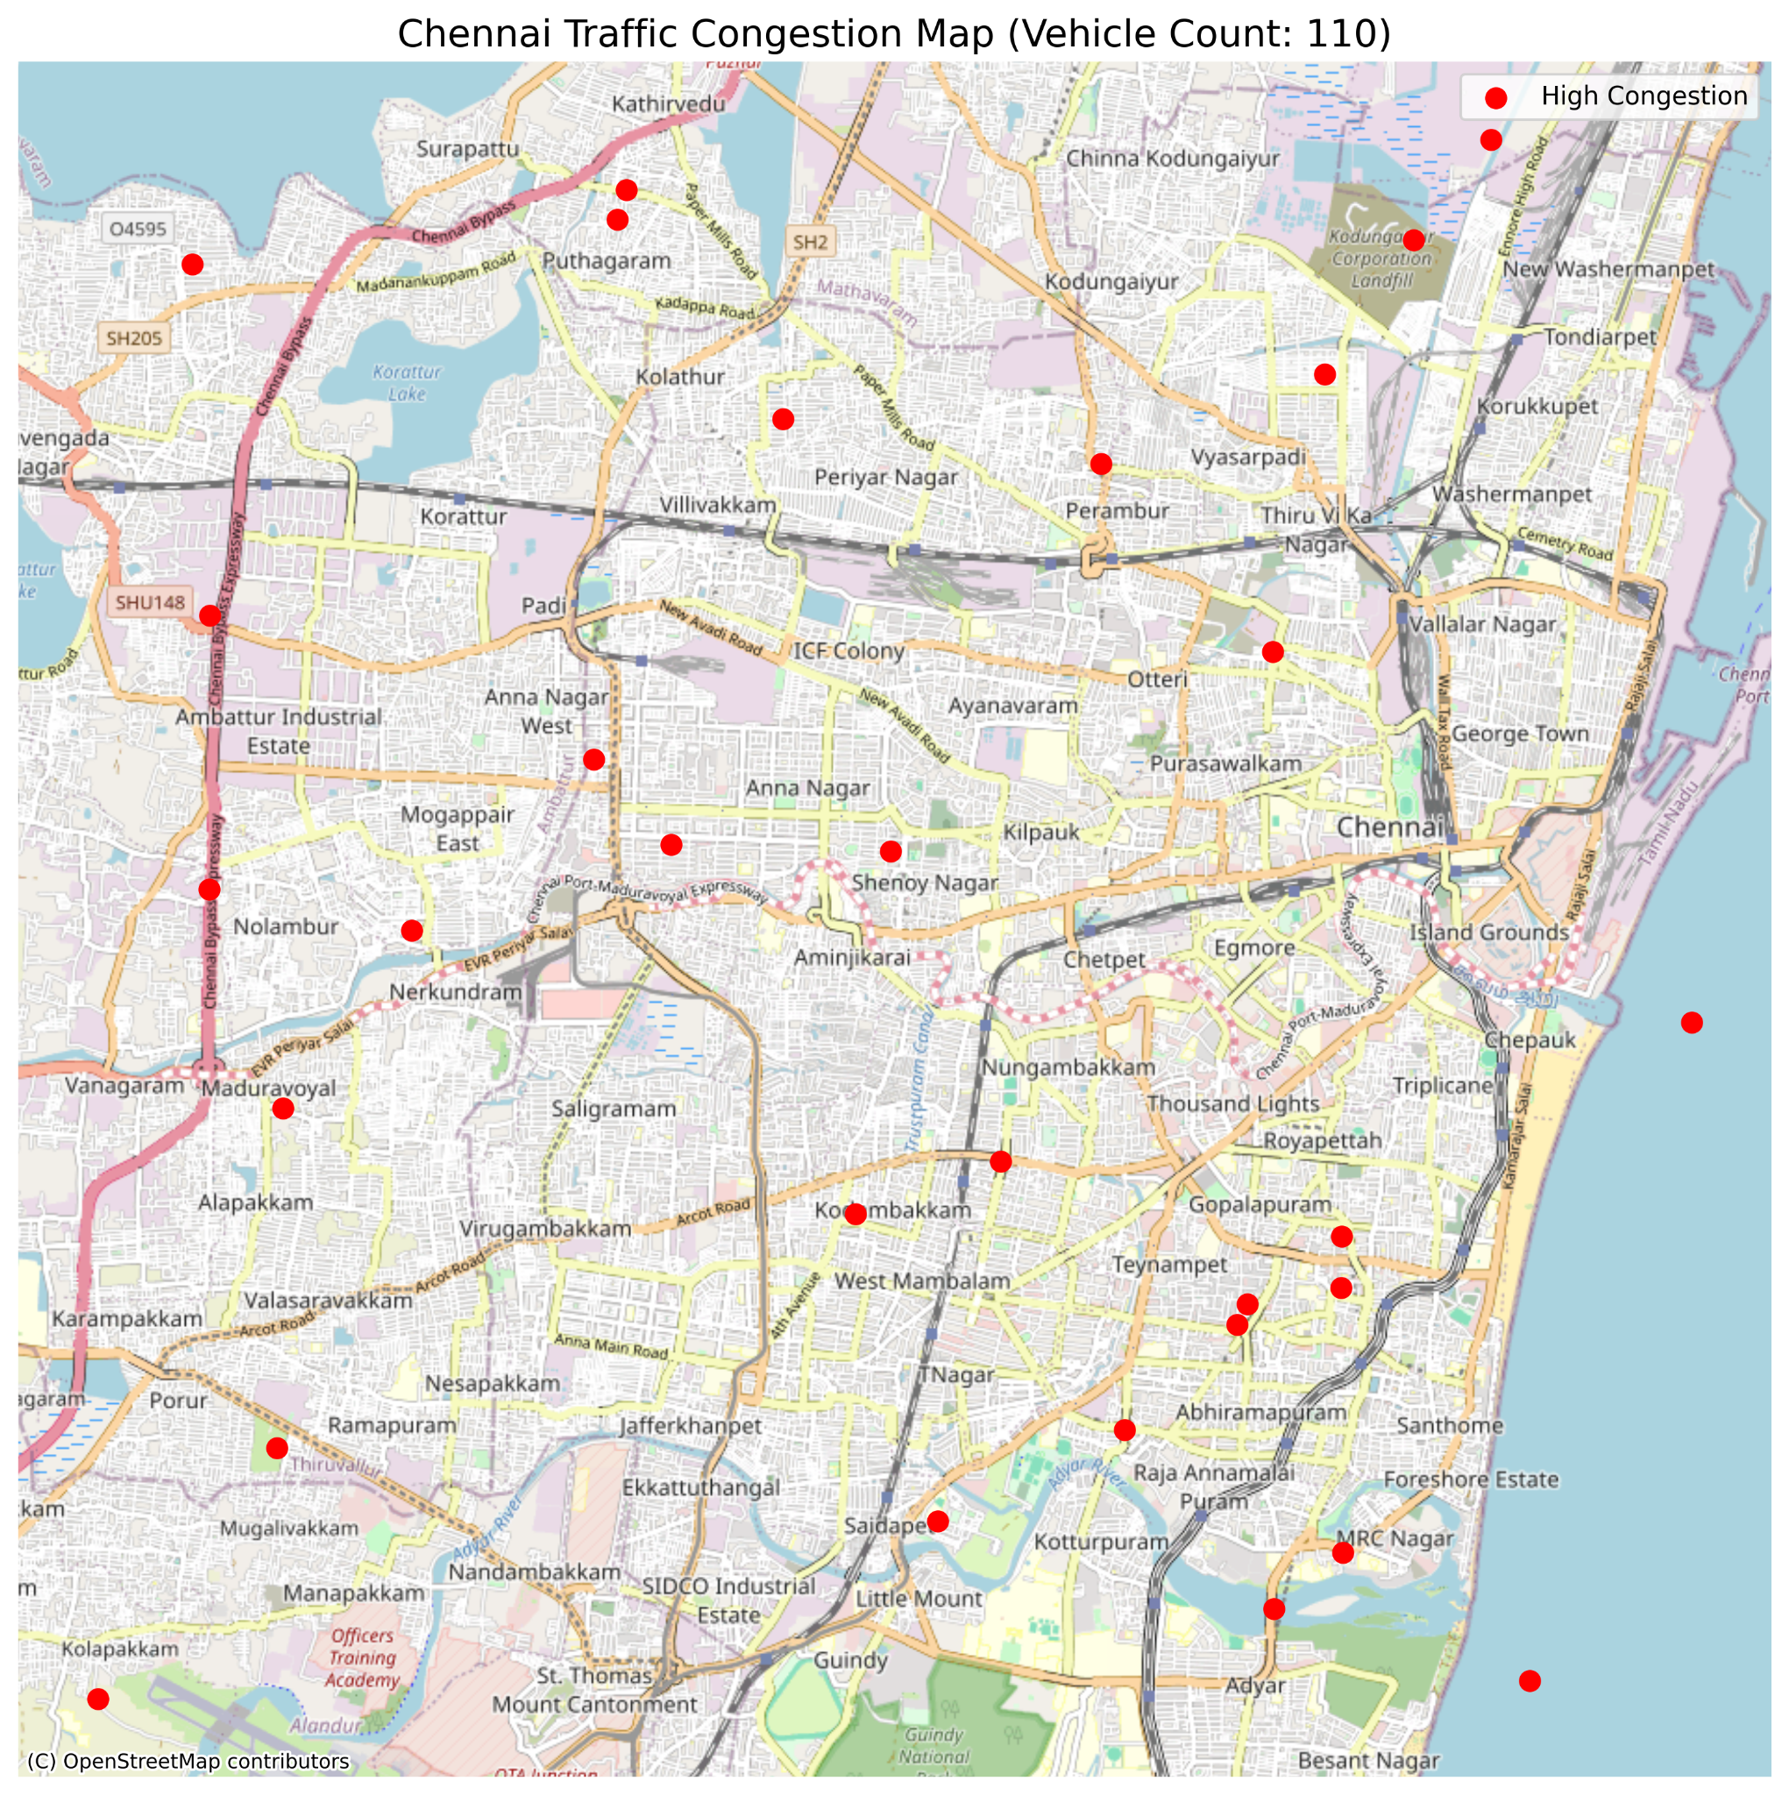
OUTPUT

Slide 9
CONCLUSION
• Lightweight and efficient traffic analysis using OpenCV.
• Congestion levels mapped without needing external deep learning models.
• Can be integrated into smart city traffic monitoring dashboards.
• Expandable with real GPS data and cloud deployment.

Slide 10

THANK YOU

